Slide 1
PROJECT DEMO
CSC301- TEAM32 FLORA

Slide 2
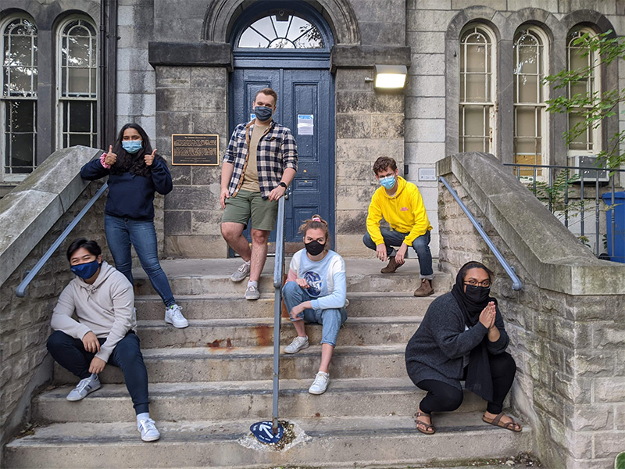
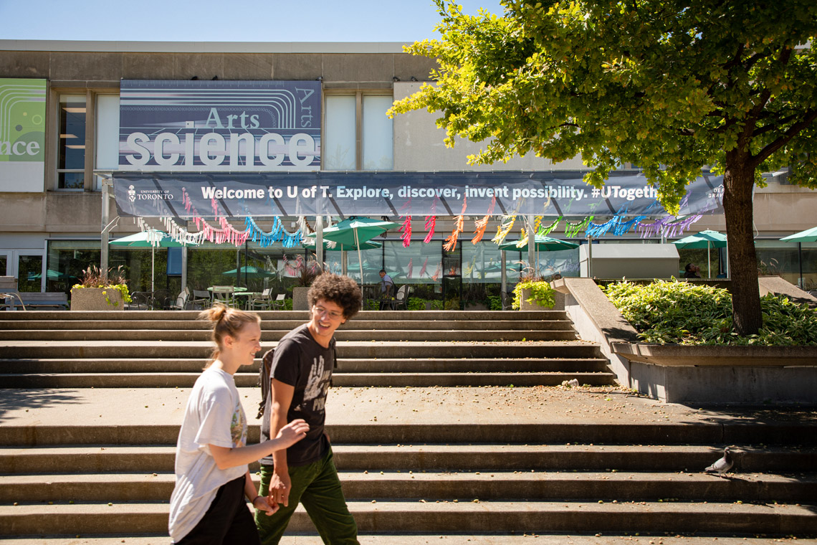
USER STORY
A U of T student wants to sell her/his old text books, iclicker, notes and other unused items.
A U of T student who wants to search for lower price, course related items and other camps related items.

Slide 3
Problems
Solution
Time consuming and difficult to gather all needed materials from a single second hand marketplace.
A centralized platform that is only for UofT students to do second hand items trading.

Slide 4
Feature1 User
Feature2 Post
Feature3 Shopping
Login and registration
email confirmation
profile with wishlist and list of posting
bought history
Post item want to sell
user information protected
upload picture and descriptions
displaying status for posting (partially done but ongoing)
check sellers profile
Add items to wishlist
bought items and received the confirmation email with the seller information
rating the seller after shopping(ongoing)

Slide 5
Demo

Slide 6
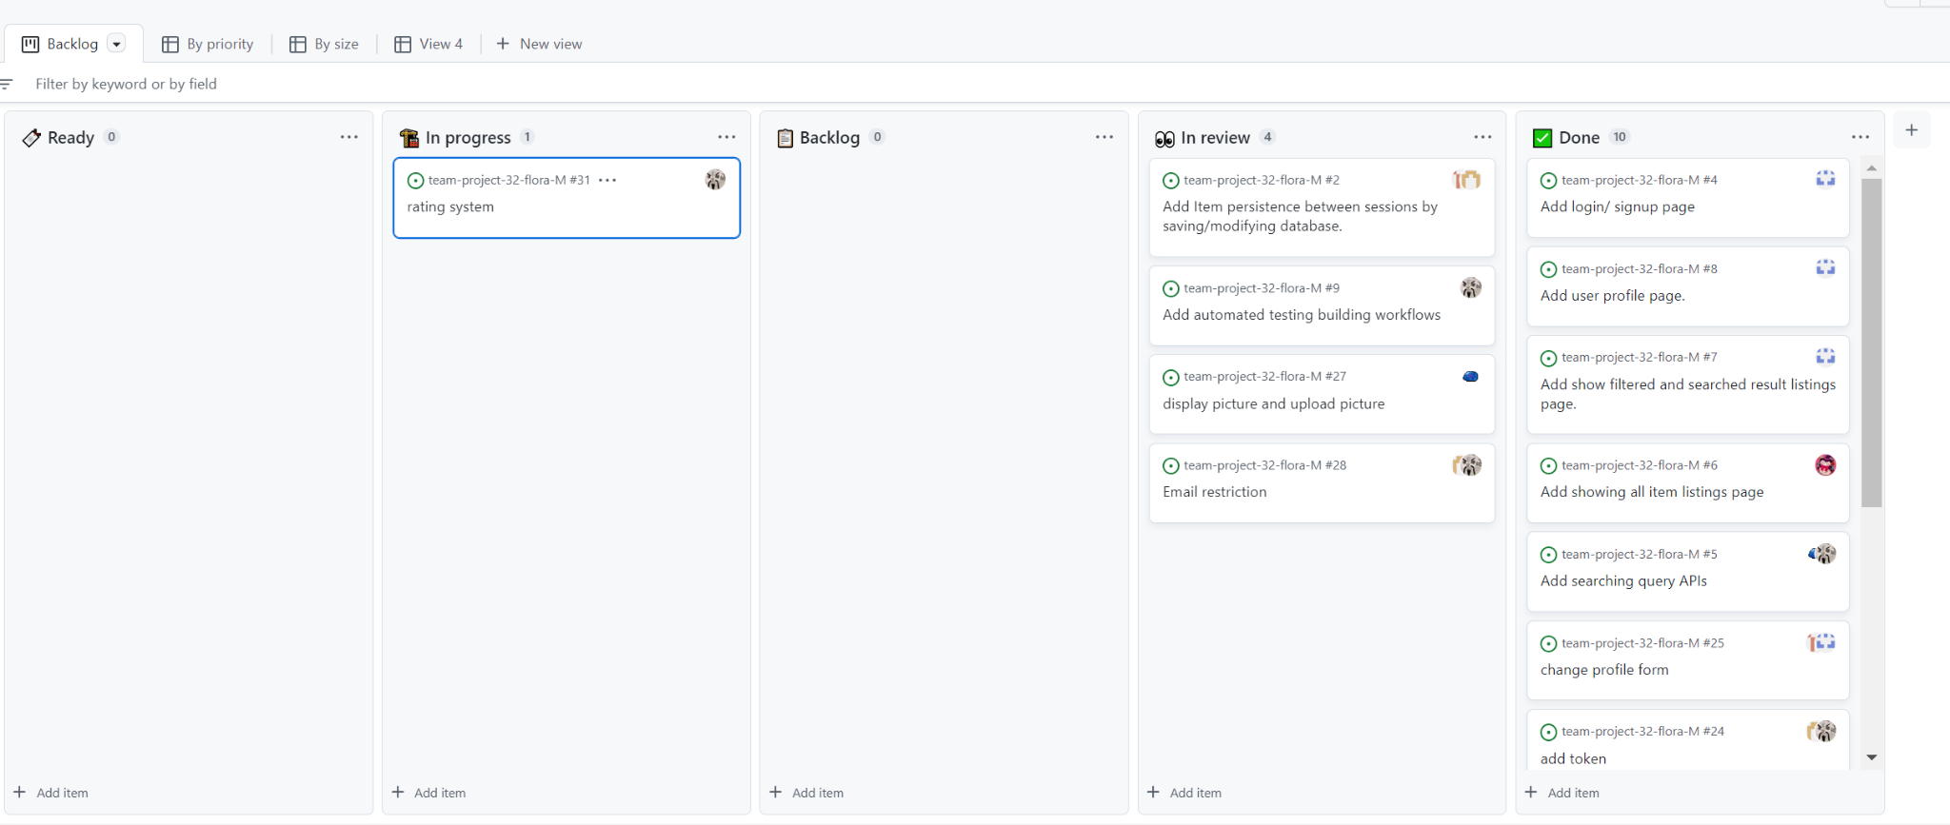
Progress — Github project

Slide 7
Handoff
Have an URL for the application
Github repository for code
Running locally instruction and deployment instruction
Guide on using application
.env file emailed
requirement.txt
commented code and meaningful name

Slide 8
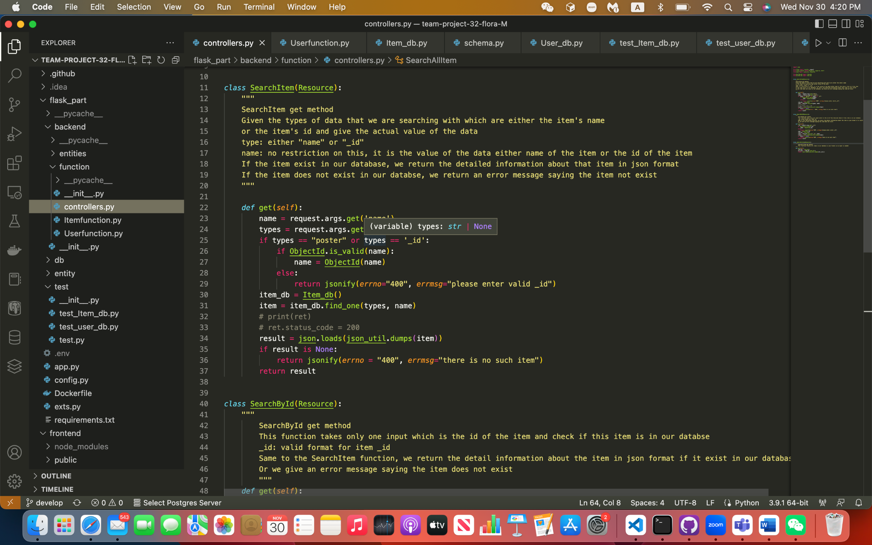

Slide 9
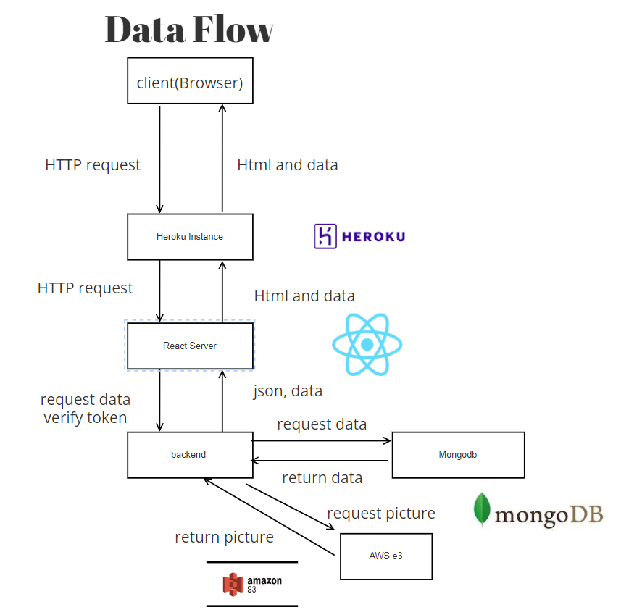
Tech Stack
& Data Flow

Slide 10
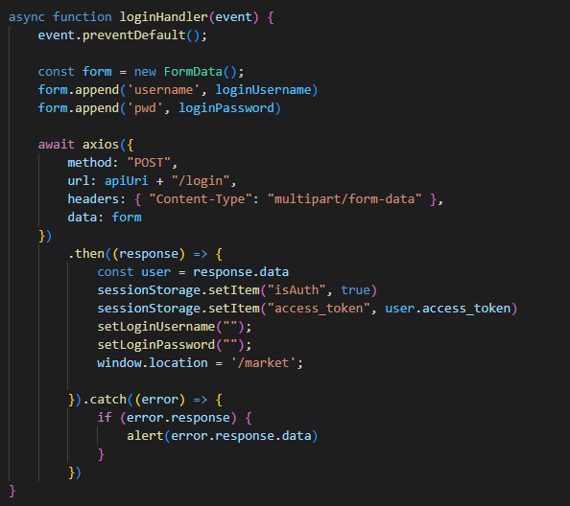
Technical Aspects
Key Frontend Libraries:
React Bootstrap
React Paginate
React Aws S3
Key Backend Libraries:
Flask JWT Extended
PyMongo
Boto3
flask-mail

Slide 11
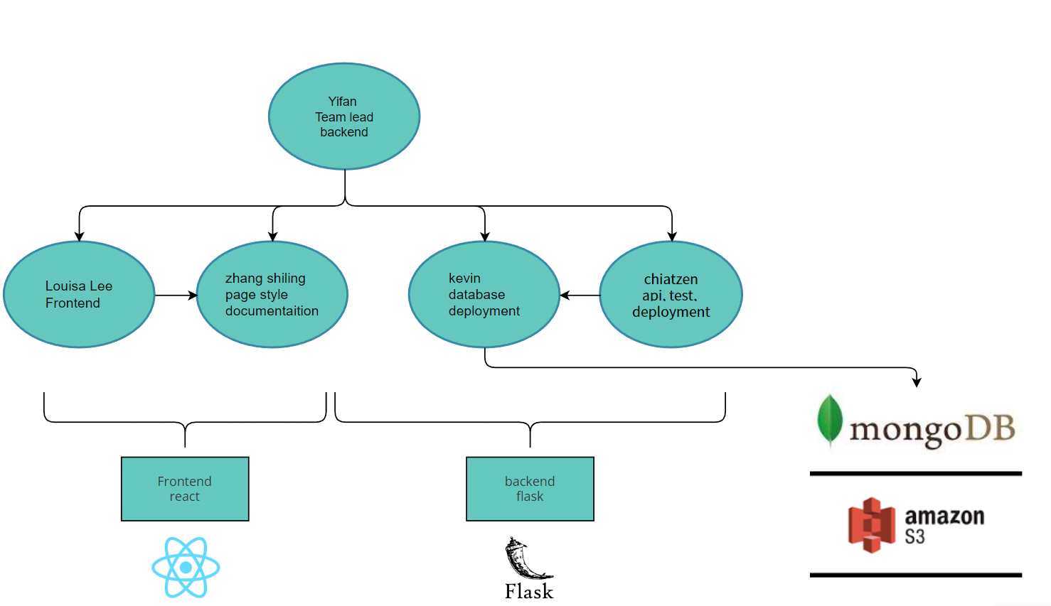
Individual Responsibility

Slide 12
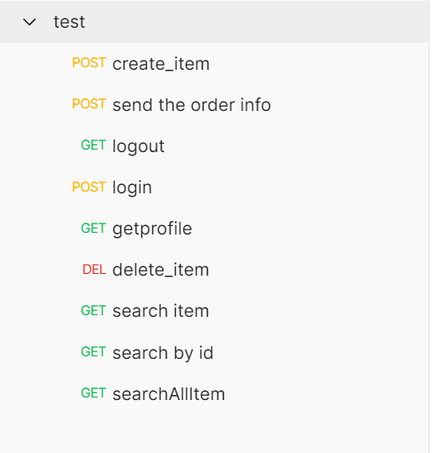
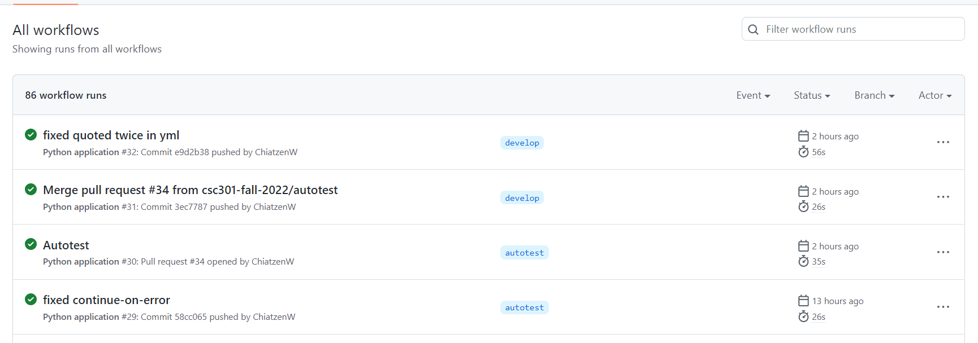
Test

Slide 13
Workflow
Meeting before deliverable deciding API rules and features
Weekly meeting discussing progress and difficulties
Use WeChat to report progress and difficulties
A branch on each feature and merge by Team Leader

Slide 14
Learning
Key learning
Not well in D2
Changes we made
Regular meeting and communication
Helpful team
self learning ability
Not starting early
Work not divided well
Not adhere to deadline
Start right away for D3
Divide up work equally
Finish before deadline

Slide 15
Individual Contribution
Name | Contribution
Chu Kwan Louisa Lee | Frontend function and designing UI
Shilin Zhang | Frontend function, designing UI and complete written documents (ex.README.md)
Yifan Zhao | Developing backend function
Kevin Cai | Database and deployment
Chiatzen Wang | Testing, deployment and APIs

